Slide 1
Visualization of Covid-19 using Tableau Public

Slide 2
What is Covid-19 and how does it spread ?
Coronavirus disease (COVID-19) is an infectious disease caused by the SARS-CoV-2 virus. Most people who fall sick with COVID-19 will experience mild to moderate symptoms and recover without special treatment. However, some will become seriously ill and require medical attention.
The virus can spread from an infected person’s mouth or nose in small liquid particles when they cough, sneeze, speak, sing or breathe. These particles range from larger respiratory droplets to smaller aerosols. You can be infected by breathing in the virus if you are near someone who has COVID-19, or by touching a contaminated surface and then your eyes, nose or mouth. The virus spreads more easily indoors and in crowded settings.

Slide 3
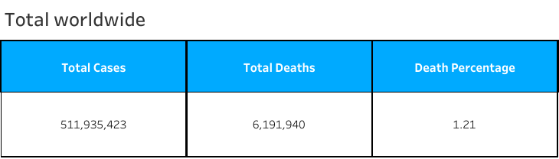
Total cases -Worldwide
As of April-2022 these are the cases as well as casualties due to novel corona virus.

Slide 4
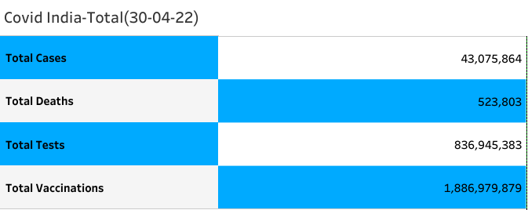
Covid India-Total

Slide 5
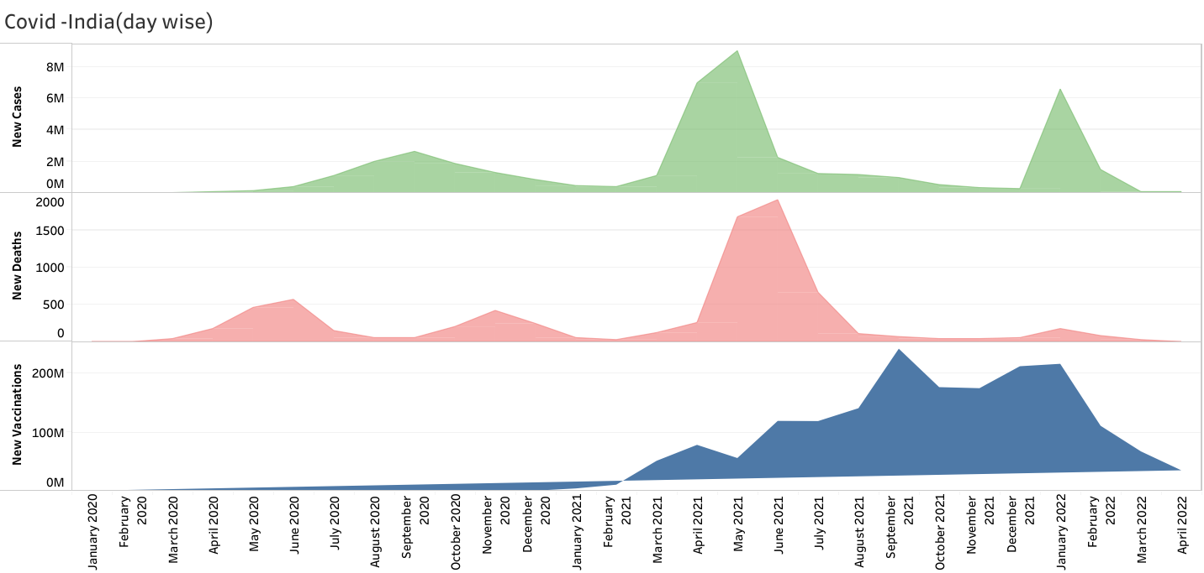
Covid total day wise

Slide 6
Inferences
- From January -20 till the end of 2020 the total number of cases was increasing but in a slow rate
- But as 2021 started there was a huge spike in the number of cases along with the death rate .
- since there was one year with a bit slow increase this gave the medical and government to work towards vaccinations.
- So even though cases and death rate did increase so did the vaccinations.
- In the beginning of 2022 there was again a slight spike in increase in cases.

Slide 7
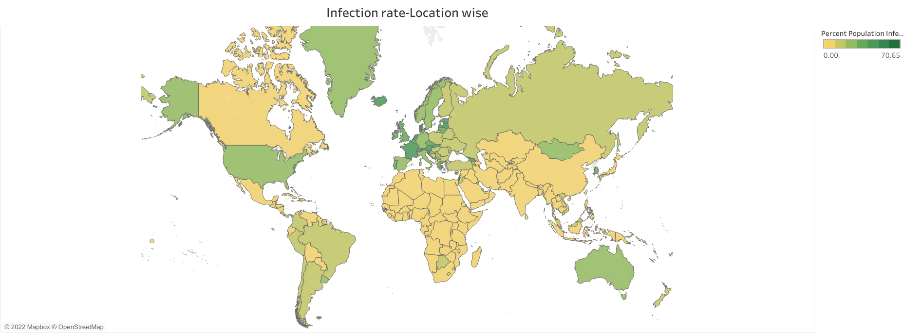
Infection rate-Location wise

Slide 8
Inferences
- Above graph shows how much of the population got infected
- Iceland had the highest number of its population infected followed by France and Latvia.
- If we consider India a total of only 3.10% of its population got affected.
- Majority of the locations had a very less number of population got affected.
To further understand how much of the population got affected in each location please follow the link below
https://public.tableau.com/app/profile/basavaraj.d4941/viz/infectionrate-location/Sheet1

Slide 9
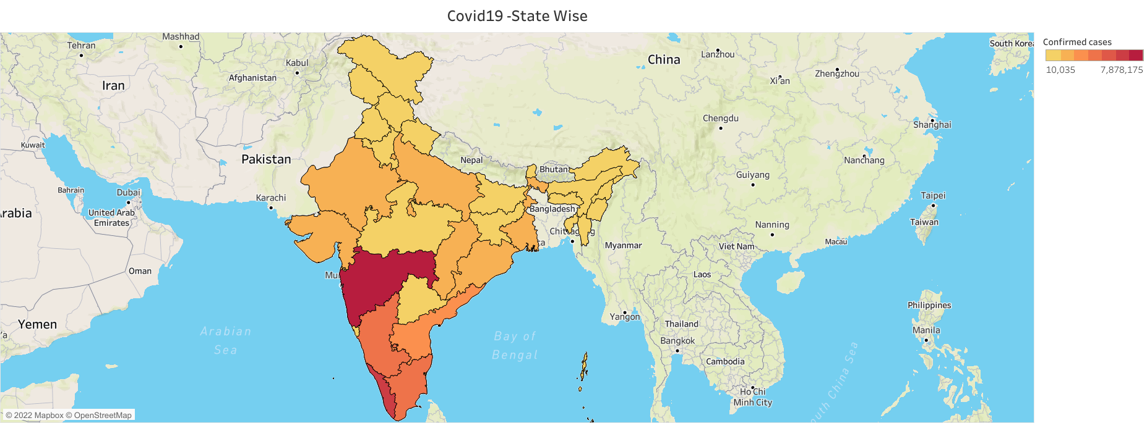
Covid India-Location wise

Slide 10
Inferences
- When taking India into consideration Maharastra had the highest number of its population infected.
- Followed by Kerala and Karnataka
- Ladakh has the lowest of its population infected.
- Considering the huge population of India we can say that the government a pretty good job in maintaining the contamination.
Please follow the link below to understand how each city fares regarding active cases as well as the total number of death cases.
https://public.tableau.com/app/profile/basavaraj.d4941/viz/covidindia-statewise/Sheet8

Slide 11
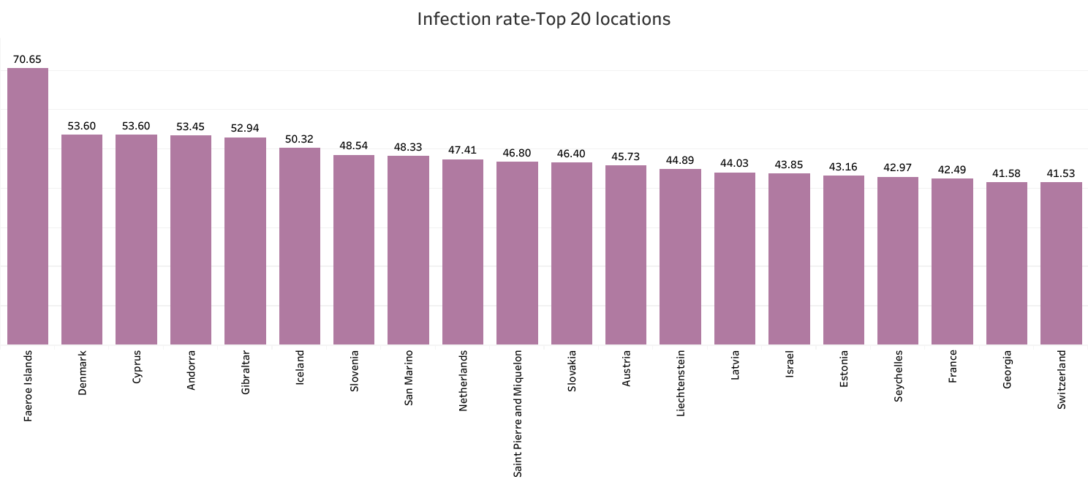
Infection rate-top 20

Slide 12
Inferences
- When considering not countries but locations Faeroe Islands has the highest number of its population infected
- followed by Denmark and Cyprus.
Please follow the link below for better visualisation.
https://public.tableau.com/app/profile/basavaraj.d4941/viz/Infectionrate-top20/Sheet3

Slide 13
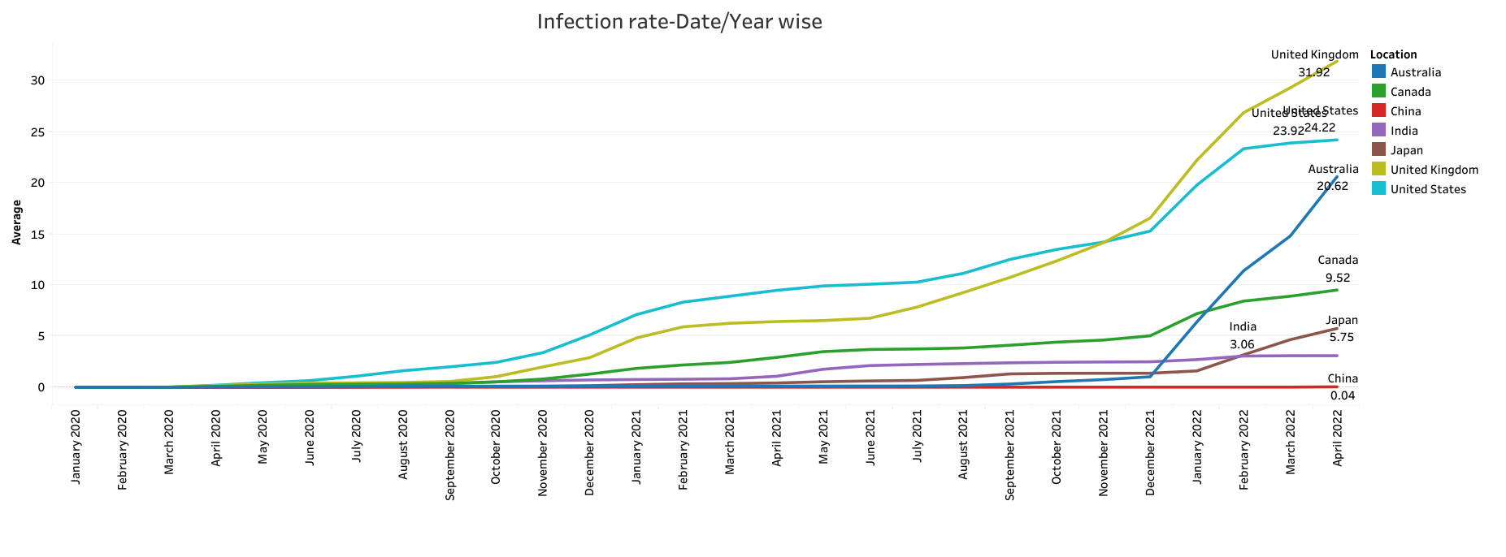
Infection rate-year wise
This is how the infection rate was between these countries
https://public.tableau.com/app/profile/basavaraj.d4941/viz/infectionrate-yearwise/Sheet1

Slide 14
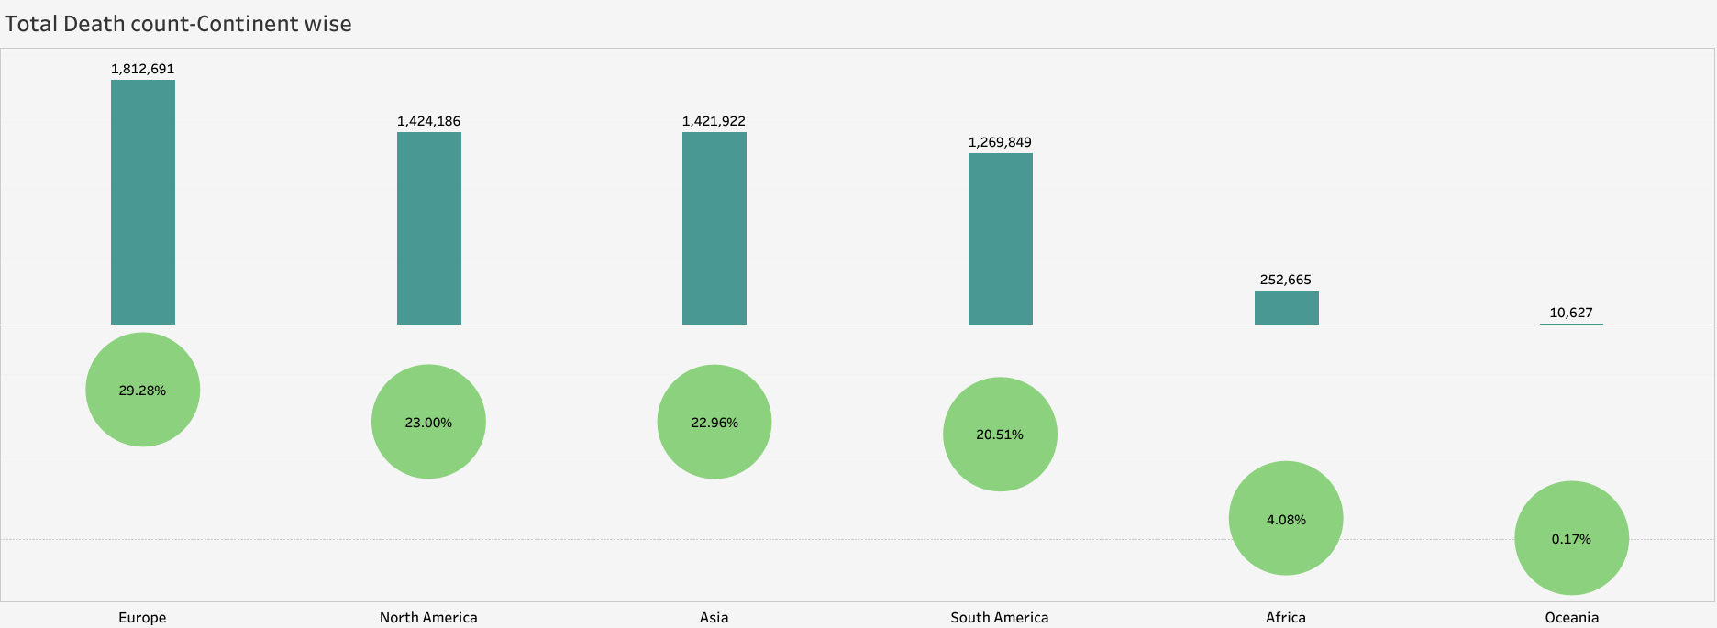
Total death-Continent
Europe had the highest death count among all other continents.
https://public.tableau.com/app/profile/basavaraj.d4941/viz/TotalDeath-Continent/Sheet2

Slide 15
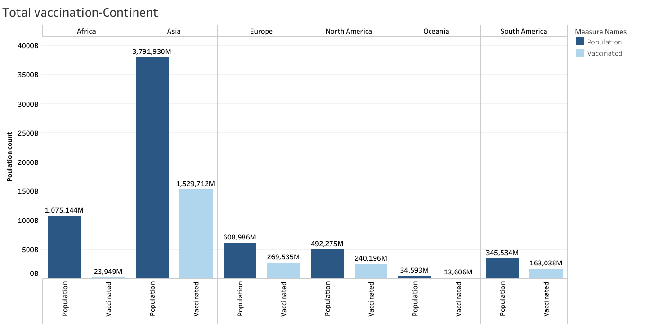
Total vaccinations-Continent

Slide 16
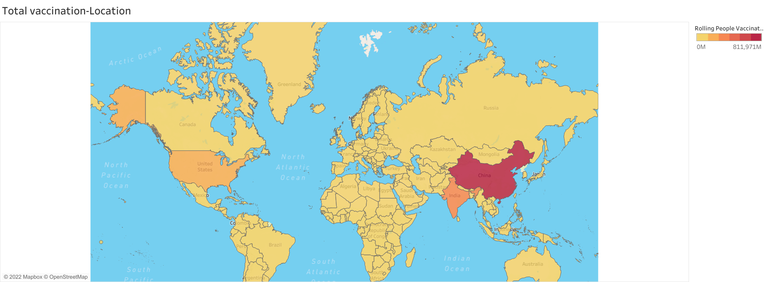
Total vaccinations-Location

Slide 17
Inferences
- Asia had the highest vaccination count followed by Europe and North America
- If we take locations instead of continents,China,India and United States were among the top 3 countries to get most of its people vaccinated.
- We cannot take the least vaccinated locations because of the unavailability of the data.
To further see how much of different countries population were vaccinated please click the link below
https://public.tableau.com/app/profile/basavaraj.d4941/viz/totalvaccinations-locations/Sheet1

Slide 18
Thank you.
Ending Note:
- This was just a simple presentation on how much covid-19 affected the world.
- The dataset regarding the subjects is so vast that it will take a very long time before we can mine every bit of information out of it.
- Thank you very much for reading through it.please visit the link to visualize the covid dataset clearly.
https://public.tableau.com/app/profile/basavaraj.d4941#!/?newProfile=&activeTab=0

